Slide 1

Predicting NBA Player Salaries
Bryce Kirby

Slide 2

Problem Statement
Introduction
When looking at the NBA it is well known for its players along with the many teams within the NBA
Purpose
The purpose behind this course project is to use predictive analytics to predict what a player’s salary should be by looking at player statistics.

Slide 3
The Process
EDA to clean or get rid of unnecessary data
Using certain algorithms
Use up to five modules to help with the course project

Slide 4
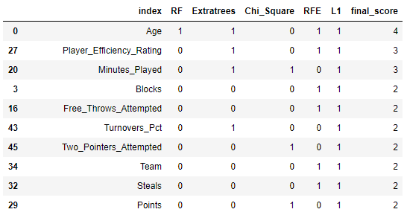
Data Preparation
Algorithms Used
Random Forest
Extratrees
Chi Square
RFE
Lasso Regression (L1)
Combining the output of the algorithms led to a list of features with the highest prediction scores
Result

Slide 5
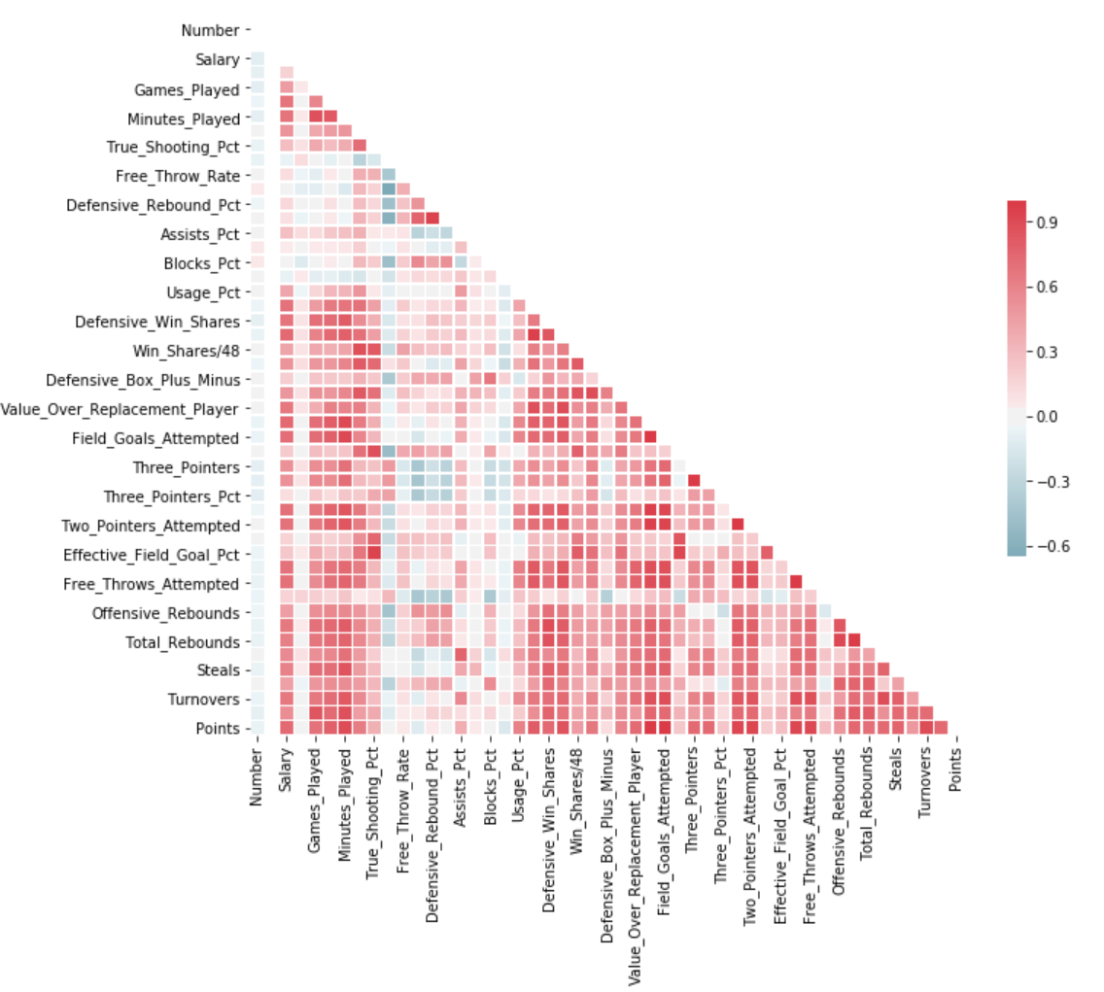
Data prep: Correlation Test
Correlation Heatmap
Process
Correlation heatmap was created
Remove obvious correlation (ex. three pointers and three pointer percent)
Strategically remove any other correlation greater than 0.9
*Some variables not displayed due to graph size constraints

Slide 6
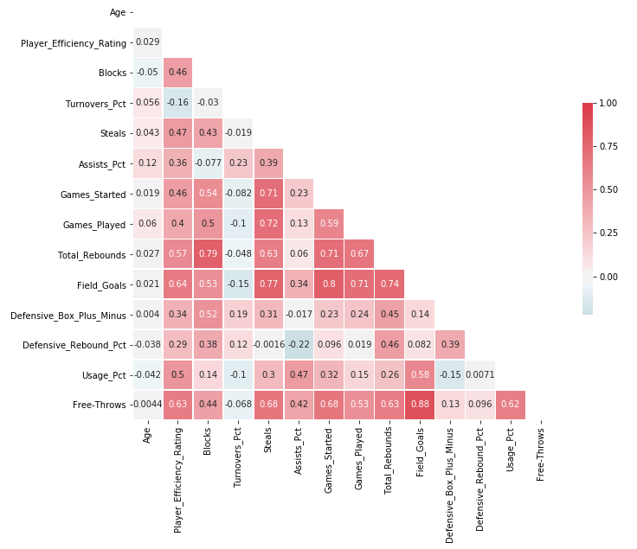
Data Prep: The Result
Selected Variables: 14
The number of features removed.
This will reduce the time and storage required to run the models.
Reduction of multi-collinearity may improve my ability to interpret results
*Some variables not displayed due to graph size constraints

Slide 7
Model 1: Ordinary Least Squares (OLS)
Approach
Results
The assumption was that there was a linear relationship between the features and the player salary
The OLS model is one of the simplest predictive models and was a good place to start with the data
The OLS method works by minimizing the sum of squares of the residuals
Model | Train RMSE | Train R² | Test RMSE | Test R²
OLS | 4398500 | 0.63 | 5024129 | 0.57
The R² values for the models indicate that I was able to account for about 60% of the salary prediction variability with the features we selected.
The RMSE values will serve as a reference point for the other linear models I am going to use.

Slide 8
Model 2: Ridge Regression (RR)
Approach
Results
Ridge regression is an extension of linear regression where the loss function is modified to minimize the complexity of the model.
This modification is done by adding a penalty parameter that is equivalent to the square of the magnitude of the coefficients.
Loss function = OLS + α* summation (squared coefficient values)
In the above loss function, α is the parameter was need to select. A low α value can lead to over-fitting, whereas a high α value can lead to under-fitting.
We will look at different values for α
Model | Train RMSE | Train R² | Test RMSE | Test R²
RR, α=0.01 | 4398504 | 0.63 | 5024400 | 0.57
RR, α=10 | 4608385 | 0.59 | 5203120 | 0.54
The R² values for the models indicate that I was able to account for about 60% of the salary prediction variability with the features were selected.
The RMSE values for the RR method are slightly higher than the OLS values. This indicates that the OLS predictions are more accurate.
Increasing the α value decreased the model accuracy.

Slide 9
Model 3: Lasso Regression (LR)
Approach
Results
Model | Train RMSE | Train R² | Test RMSE | Test R²
LR, α=0.01 | 4398500 | 0.63 | 5024129 | 0.57
LR, α=100 | 4398502 | 0.63 | 5023978 | 0.57
Lasso regression is also a modification of linear regression. In Lasso, the loss function is modified to minimize the complexity of the model by limiting the sum of the absolute values of the model coefficients.
Loss function = OLS + α* summation (absolute values of the magnitude of the coefficients)
In the above loss function, α is the penalty parameter we need to select.
We will look at different values for α
The R² values for the models indicate that I was able to account for about 60% of the salary prediction variability with the features selected.
The RMSE values for the LR method are essentially identical to the OLS values. This indicates that the OLS and Lasso predictions are basically the same.
Increasing the α value had little impact on the model accuracy.

Slide 10
Model 4: ElasticNet Regression (ENR)
Approach
Results
Model | Train RMSE | Train R² | Test RMSE | Test R²
ENR, α=0.01 | 4432638 | 0.62 | 5070003 | 0.56
ENR, α=10 | 7010747 | 0.06 | 7488845 | 0.05
ElasticNet combines the properties of both Ridge and Lasso regression.
Loss function = OLS + α* summation (absolute values of the magnitude of the coefficients) + α* summation (squared coefficient values
In the above loss function, α is the penalty parameter we need to select.
We will look at different values for α
The R² values for the models were still around 60%, but were slightly lower that what we saw with the other models.
The RMSE values for the ENR method were the highest of all the models. This indicates the least accurate prediction model. This is likely due to the fact that I removed features that were highly correlated with one another.
Increasing the α value had a negative impact on our prediction accuracy.

Slide 11
Model 5: Extreme Gradient Boosting Regression (XGBR)
Approach
Results
XGBR is an ensemble modeling technique where new models are added to correct the errors made by existing models.
The method uses the gradient boosting decision tree algorithm.
Gradient boosting is an approach where new models are created that predict the residuals or errors of prior models and then added together to make the final prediction.
Model | Train RMSE | Train R² | Test RMSE | Test R²
XGBR | 1818766 | 0.92 | 4531190 | 0.65
The R² values for the XGBR method were the best of all models evaluated. Our training set R² had a value of 92%, which is excellent. The results diminished to only 65% when applied to the test set, but this about 10% better than the other models.
The RMSE values for the XGBR method were also the lowest of all models evaluated. This indicates the most accurate prediction model.

Slide 12
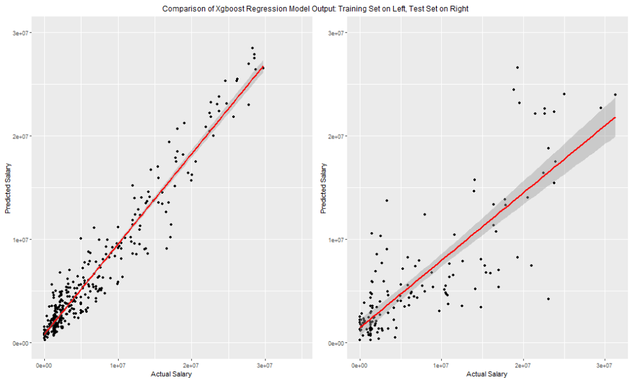
Results

Slide 13
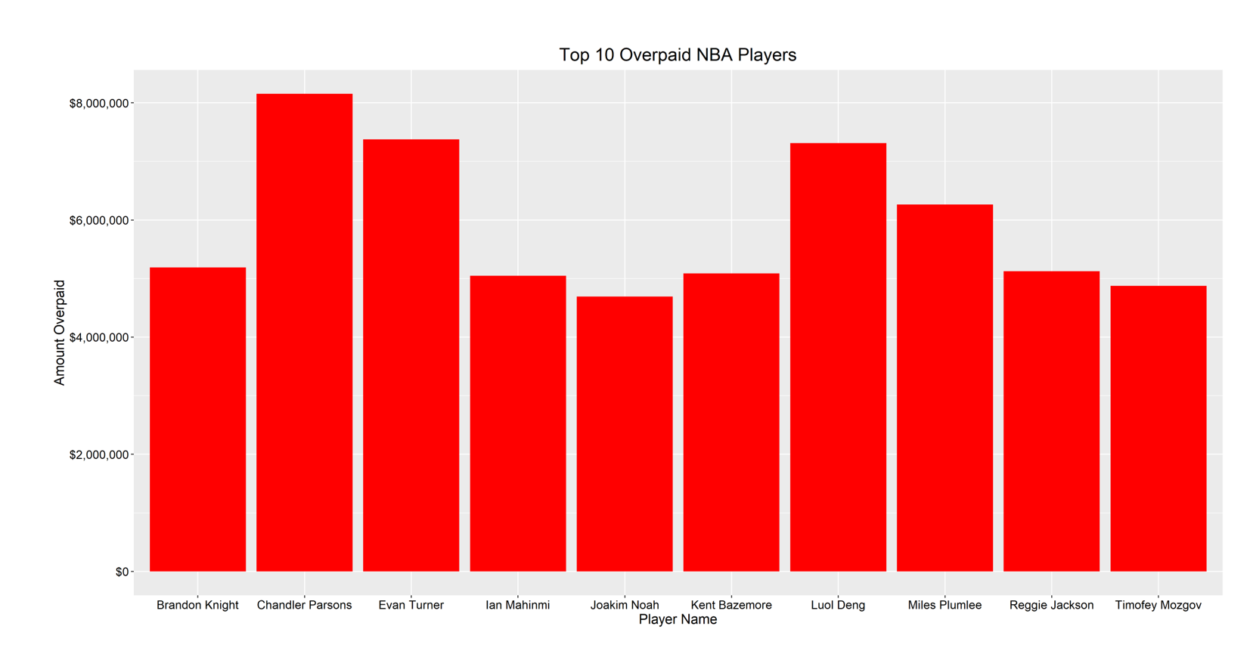
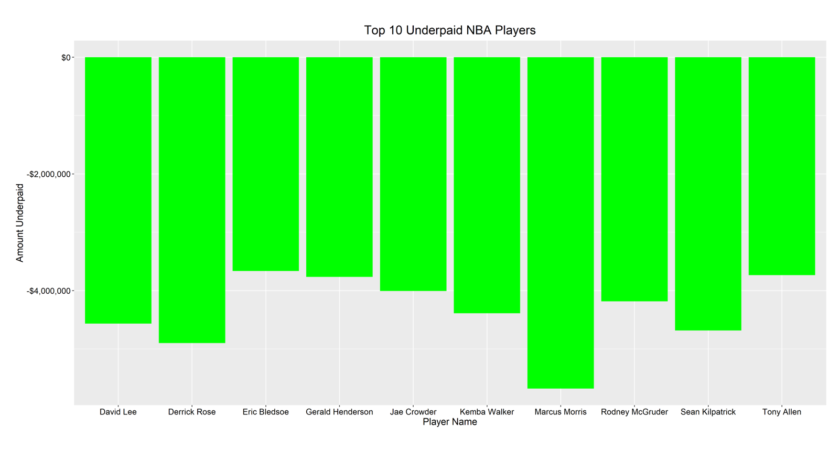
Conclusion

Slide 14
References
C., A. (2018, October 20). NBA player stats 2017-18. Kaggle. https://www.kaggle.com/datasets/acasalan/nba-player-stats-201718/data
HoopsHype. (n.d.). These are the 2016/17 salaries of all NBA teams. HoopsHype. https://hoopshype.com/salaries/2016-2017/

